Slide 1
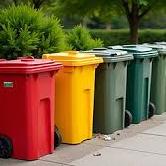


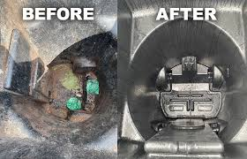
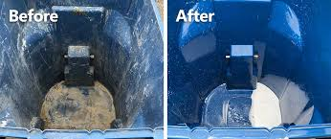
DUMPSTER DIVER
**Evaluation of Production Paths Forward**
Brag & Bev LLC
John Braganini, Apollo Braganini, Sarah Braganini, Candice Aaron and Jacob Bevier

Slide 2






Approach to Finding a New CHEMIST

Slide 3


Universities / Colleges / Institutions
University of Minnesota
Georgia Tech (multiple departments, incl. Rodney Weber contact)
North Carolina State University (multiple departments)
Stony Brook University
Virginia Commonwealth University (VCU)
Purdue University
University of California, Irvine (UCI)
Central Michigan University
California Polytechnic State University (Cal Poly)
Texas A&M University (tamu.edu)
Colorado State University
Skidmore College
University of California, San Diego (UCSD)
Miami University
University of South Florida
University of New Mexico
New Jersey Institute of Technology (NJIT)
University of Michigan (multiple departments)
Imperial College London
University of South Carolina
Washington University in St. Louis (wustl.edu)
University of Texas
Tulane University
University of Maryland
University of Maryland School of Pharmacy (separate department)
Clarkson University (clarkson.edu)
University of Denver (du.edu)
University of Edinburgh (ed.ac.uk)
University of Washington (uw.edu)
University of Utah (utah.edu)
University of California, Los Angeles (UCLA)
University of Warsaw, Poland (uw.edu.pl)
Virginia Tech (vt.edu)
University of North Dakota (und.edu)
Lund University, Sweden (lth.se)
University of Iowa
Penn State University

Slide 4

Companies / Labs / Other Institutions
Freelance Formulations
Beakers and Bottles
ARE Labs
ATS (Aerosol Technical Solutions – via John Chadwick)
Uno FormulationsDesign.lth.se (likely tied to Lund University design group)

Slide 5

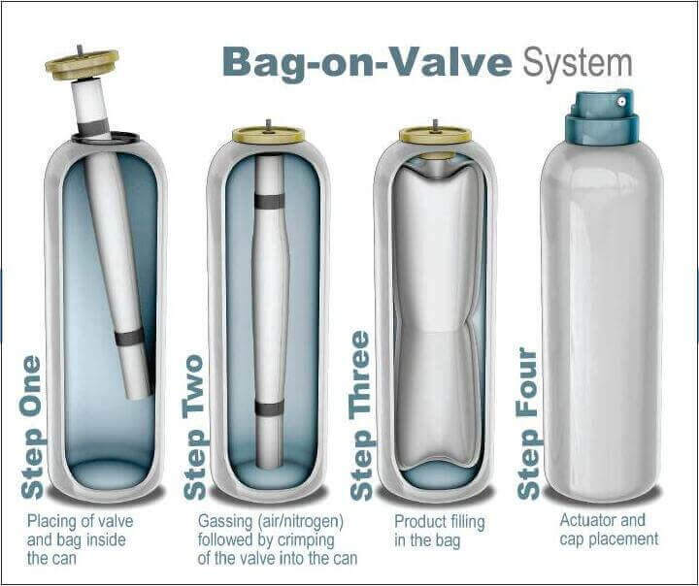

Path 1: DIY Formulas => MB Industries (BOV)
Aerosol Research and Engineering Labs
Process: Source our own chemicals, mix/test small 1L batches, ship to MB Industries, Pennsylvania => MB fills into BOV cans => they send back units to test.
Regulatory: No VOC concern; BOV is air-powered.
Cost: Approximately $1,000 for chemicals and supplies for initial formulation batches.
BOV is usually 20–50% more expensive than a comparable traditional aerosol.
On a per-unit basis, depending on volume:
Traditional aerosol filling: $0.15–0.30 extra cost per can.
BOV filling: $0.40–0.60 extra cost per can
Pros: Full control of formulation, BOV = eco-friendly marketing edge.
Cons: Slower, more bench work on my end, even with the DIY could be more costly in the long run.

Slide 6


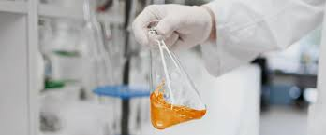
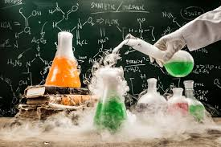
4 DIY Formulations
F1 — Baseline Foaming Cleanser — 1 L Batch Card
Goal: Simple, clear, stable; good foam; VOC-free; BOV-ready. | Target pH: 5.8–6.0 | Viscosity: »250–400 cP
F2 — Boosted Cleaning (Hydrotrope + Co-solvent) — 1 L Batch Card
Goal: Better grease/soil tolerance; remains BOV-sprayable. | Target pH: 5.8–6.0 | Viscosity: »250–450 cP
F3 — Heavy-Duty Anionic System — 1 L Batch Card
Goal: Stronger cleaning; clearer rinse; anionicnforward. | Target pH: 5.8–6.0 | Viscosity: »300–600 cP
F4 — Advanced (Builders + Polymer Anti-redeposition) — 1 L Batch Card
Goal: Highest performance; watch clarity/viscosity & filtration. | Target pH: 5.8–6.0 | Viscosity: »300–600 cP

Slide 7

Path 2: SprayProducts (Conventional Aerosol)
Process: SprayProducts handles formulation + nozzle pairing + filling.
Regulatory: VOC compliance not a problem (their expertise).
Notes: They emphasized confidence, attitude, and alignment with our vision.
Pros: Fastest to manufacturable solution, strong technical partner.
Cons: Standard aerosol format (less eco-friendly than BOV), VOC compliance still applies.

Slide 8
Overview
Path | Partner | System | VOC Compliance | Cost Impact | Speed | Notes
DIY + MB Ind | MB Industries | BOV | No Concern / Filled with Air | + $0.15-$0.30/can | Slowest | You mix, they fill
SprayProducts | SprayProducts | Aerosol | Not an issue | Standard | Fastest | Very confident in their capabilities

Slide 9
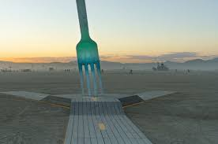


Fork in the Road

Slide 10
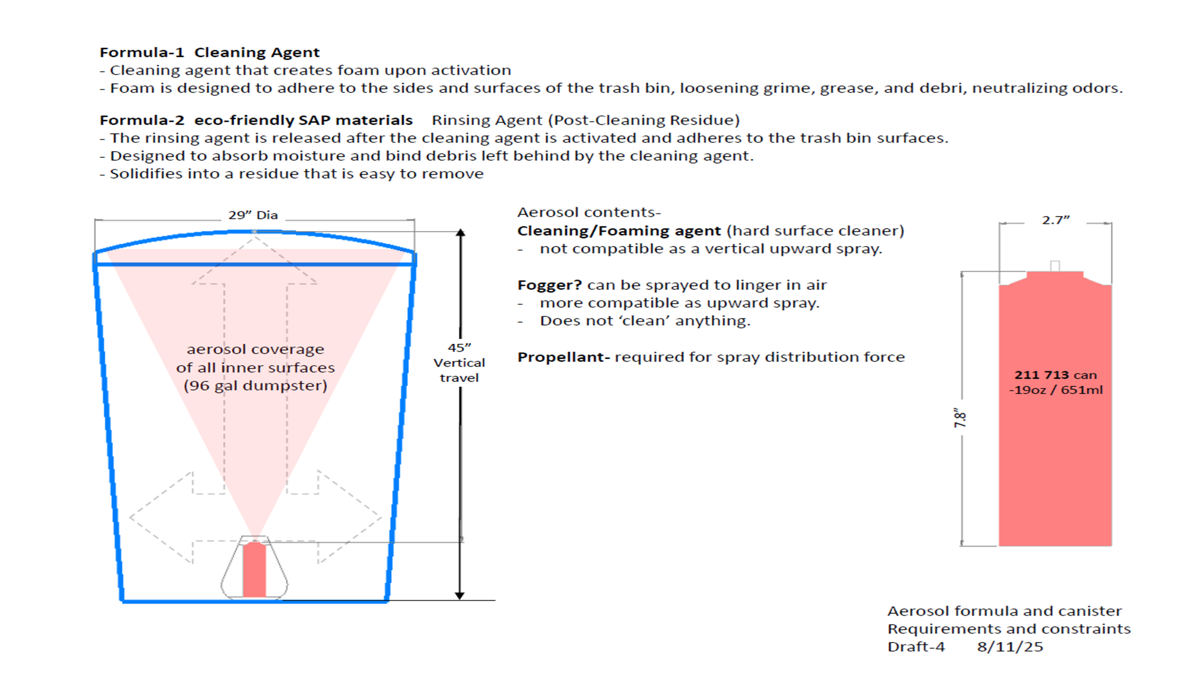

Slide 11
